Slide 1

Marking menus for
Guillaume Galliano Bondurand & Mathieu Mansanarez

Slide 2
Outline
Introduction
Definition
Usability
Constraints and solutions
Constraints linked to the Mobile environment
Suggested solutions
Effective implementation

Slide 3
Introduction
Revised form of a Radial Menu (or circular menu),
Enhanced with an arborescence allowing depth exploration,
3 times faster than a linear context menu,
Used in few softwares (Maya, etc…)

Slide 4
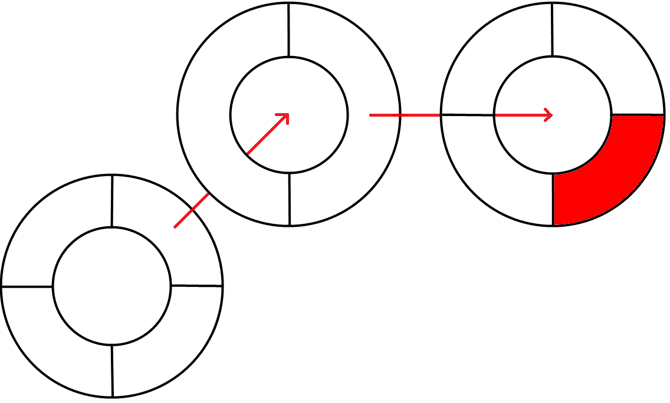
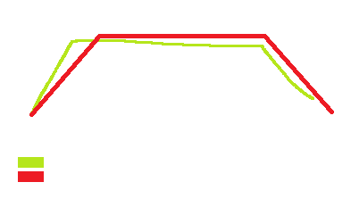
Introduction
Introducing 2 different modes
Novice mode
Expert mode

Slide 5
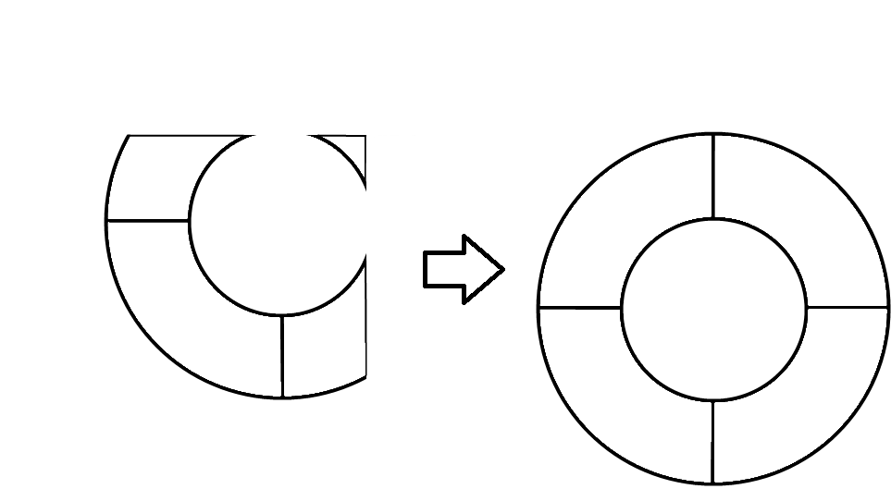
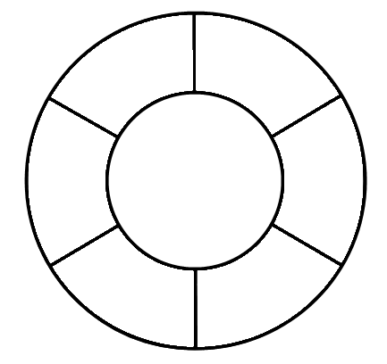
Constraints & Solutions
The size of the screen
Can’t draw wherever we want
we apply an offset
Can’t draw too many items
we set the limit to 6

Slide 6
Effective Implementation
Followed the standard official Android GUI procedure,
For the novice mode:
Used a drawing arc method,
Computed the angle and the distance to mark,
Long press on an item shows its sub-items.
For the expert mode:
Drawn all the points,
Detected articulation points,
Drawn the decrypted pattern,
Browsed the arborescence of items.

Slide 7
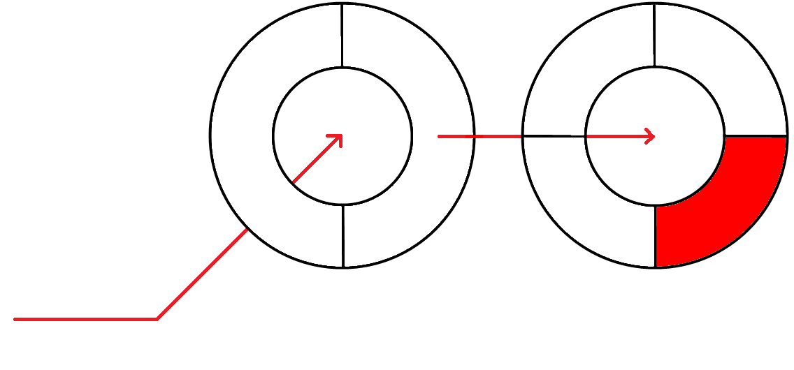
Possible Improvements
Decrease sensibility,
Increase precision,
Enhance the recognition algorithm,
Provide a nice looking button to switch mode when reaching a non-leaf item.

Slide 8
References
http://developer.android.com/guide/topics/ui/custom-components.html
http://www.markingmenus.org/
https://github.com/strider2023/Radial-Menu-Widget-Android
Questions ?

